Slide 1
Task 1.6 Usability Test
Submitted by: Minal Bombatkar

Slide 2
Usability Test Plan
Testing : The usability of our new vocabulary learning app
SCOPE
Test Usability for a Language Learning App
SCHEDULE
Follow “Unmoderated tests method” using video call app
SESSIONS
about 10 min to 15 min meeting with 3 users
EQUIPMENT
Computer, Android phone used for Prott App
METRICS
Jakob Nielsen’s severity rating scale
0 = I don't agree that this is a usability problem at all
1 = Cosmetic problem only: need not be fixed unless extra time is available on project
2 = Minor usability problem: fixing this should be given low priority
3 = Major usability problem: important to fix and should be given high priority
4 = Usability catastrophe: imperative to fix before product can be released

Slide 3
DIRECT TASKS
SCENARIO TASKS
Sign up process for first time user
2. User will learn new vocabulary from Dictionary feature
3. User will memorise the vocabulary using Flash cards
4. Study Vocabulary Set from existing lists or create own set
5. Adding study remainder alarm as per available time of user
1. This is Vocabulary app which can help you learn new
Vocabulary with correct pronunciation and practices your vocabularies by playing Flash cards game.
How would you start as a first time user?
2. Once you have created an account, you can automatically
log in from your phone anytime, anywhere when you want. Which method you prefer to start learning?
3. The dictionary feature of app provides reading, listing and hearing the definition of the new words with examples, What do you do to memorise the new words?
4. In Flash cards feature, it help to create own set, how would you do so? How would you add new vocabulary or edit old ones?
5. To keep user motivated for learning there is Remainder alarm feature. Do you think it will work for you? And how?

Slide 4
INTERVIEWE - KATE
Task 1. Sign up process for first time user
Signing up for an account was easy, but I may suggest, “quick logins” option would to push people who use FB/Google/etc, But overall the sign up process was very easy.
Task 2. User will learn new vocabulary from Dictionary feature
It is best thing about app, I don’t need to carry my dictionary with me to find the meaning of the new words or not even switch to other translating app while learning. Design is easy to use and simple in look.
29 years,
Post bank officer
“I like the simplicity of the app, I think you did a great job with that. Definitely, the final product will looks very clean.”
Task 3. User will memorise the vocabulary using Flash cards
Flash card feature is easy to use, just choose the card read the term and swap the card for definition. But I don’t find edit option for existing cards. Suppose I want to change the definition or Terms, it should be there.
Task 4. Study Vocabulary Set from existing lists or create own set
I like to create my own set, button is easy to click, and again Edit option is missing.
Task 5. Adding study remainder alarm as per available time of user
This is cool feature, It will help me to learn new language without disturbing my daily schedule and remind me on time.

Slide 5
INTERVIEWE - LOUIS
Task 1. Sign up process for first time user
Sign up is easy. It's very easy and fast to learn for the app.
Task 2. User will learn new vocabulary from Dictionary feature
It's easy to take the start once you login - everything is very
straight forward. It is simple to find my favourite words bellow on the task bar button.
Task 3. User will memorise the vocabulary using Flash cards
Flash card feature is easy to use, Suggest to add more graphical themes than textual.
32 years,
Ex-Military man
“I prefer to learn with fun, a gaming base study experience, that make me relax.
"Your app doesn't need me to
Overthink. It’s easy and so clear to understand.”
Task 4. Study Vocabulary Set from existing lists or create own set
Ohh, it is great that I would able to create my own set.
However, I think the back button should be in most pages, so I
can always go back.
Task 5. Adding study remainder alarm as per available time of user
It is good to have it. But I am Ex-Military man, It will not so useful for me. I have lot of free time. I find adding alarm remainder, it is in vary standard format.

Slide 6
INTERVIEWE - ANNA
Task 1. Sign up process for first time user
Super easy and as per standards.
Task 2. User will learn new vocabulary from Dictionary feature
It combine the traditional learning vocabulary method with new style. Search feature make it straight forward to find any new term. I should expect to see my progress some where in the app.
Task 3. User will memorise the vocabulary using Flash cards
Flash card feature is necessary to check the knowledge. It is simple to understand and use. I suggest that the language of pronunciation able to change.
23 years,
Medical student
“Variation of the learning make me motivated than only one way of learning, I find all there main features are very necessary and essential.”
Task 4. Study Vocabulary Set from existing lists or create own set
This method of using a memory trick really helps me learn
new words quicker and expands my memory.
Task 5. Adding study remainder alarm as per available time of user
Remainder of study is so impotent to keep on track. I find this design is best because user don’t need to find the alarm to set, it is on the welcomepage of the app.

Slide 7
Task # | Observation | Severity | Recommendation
1 | User suggested that “quick logins” i.e. login using social media FB/Google/etc. option would available. | 3 | The current login process seemed pretty straight forward to users. But having “Quick login” option, It will help to save time and avoid to forget account credentials.
2 | User misses the progress bar in app. | 3 | Progress bar is help to keep the track of the user.
3 | User suggested that “Edit option” for set in the Flash card menu would be there. | 4 | “Edit option” in the set menu help to rewrite and reorganised the structure of the Flash cards. It is on high priority.
4 | User misses a back button on the “every single” pages. | 2 | On most of pages there is Home page logo bellow on bar. It is not necessary that it should be on every single pages.
5 | User suggested that there will be option for changing the pronunciation language. i.e. British, American. Etc. | 1 | It is not so necessary feature for the app.
Ref: Jakob Nielsen’s severity rating scale

Slide 8
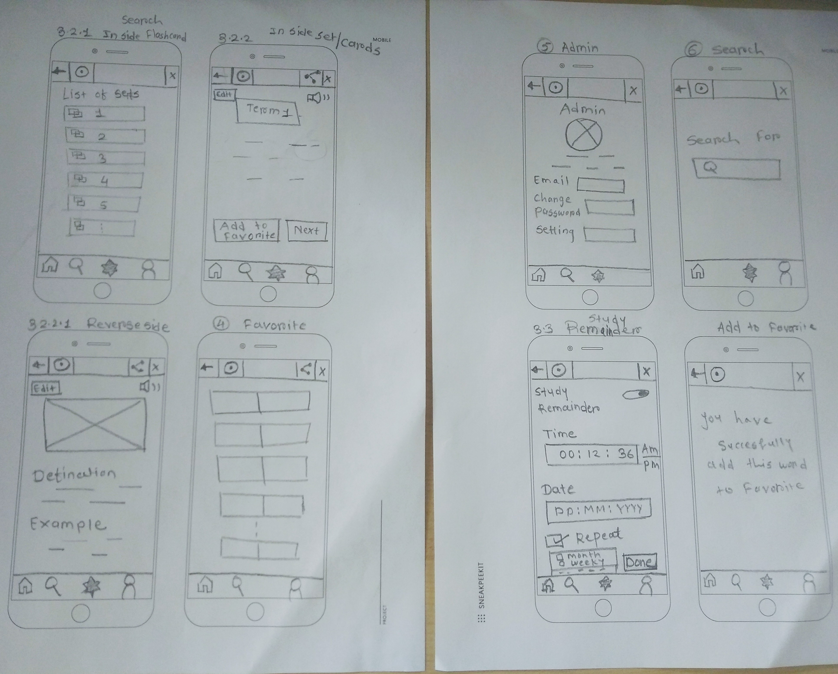
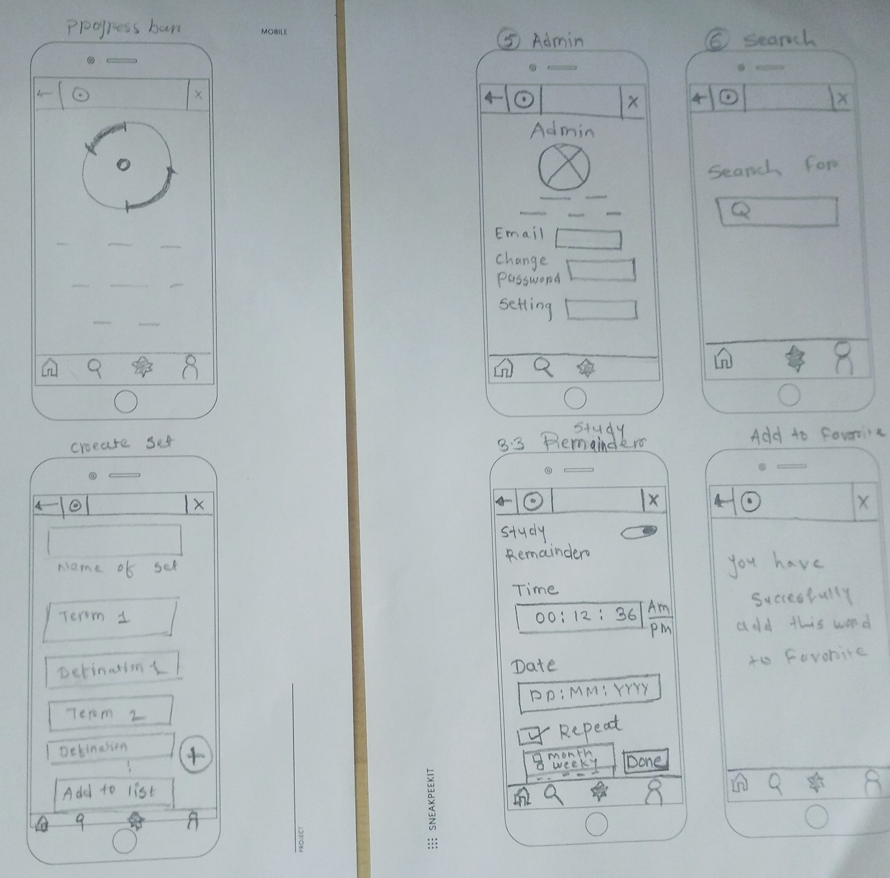
Paper Wireframes for Revised Prototype

Slide 9
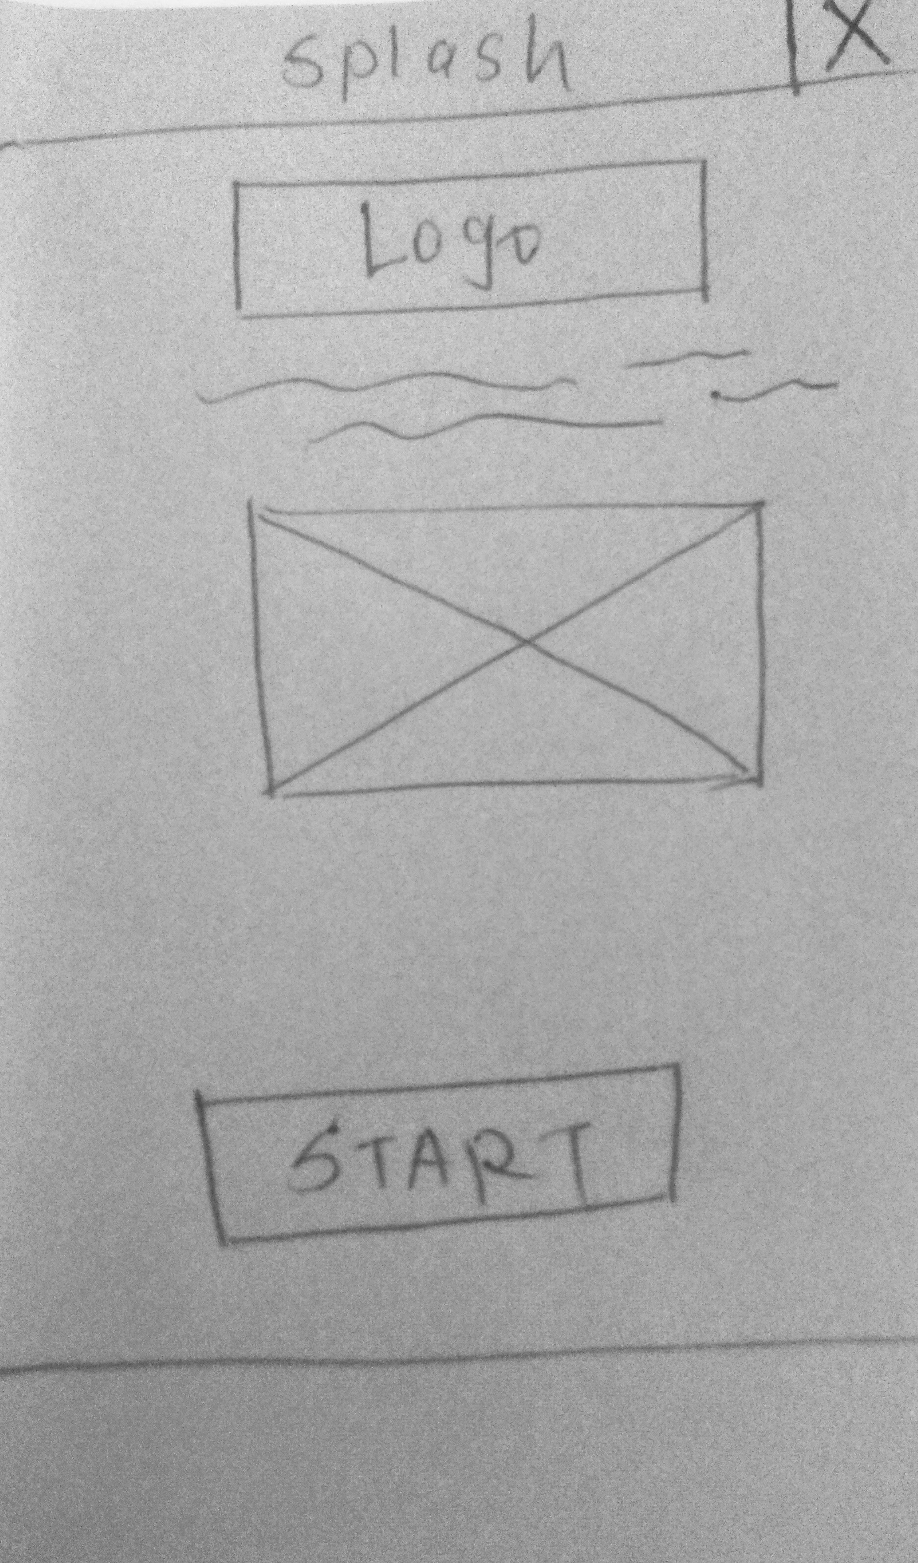
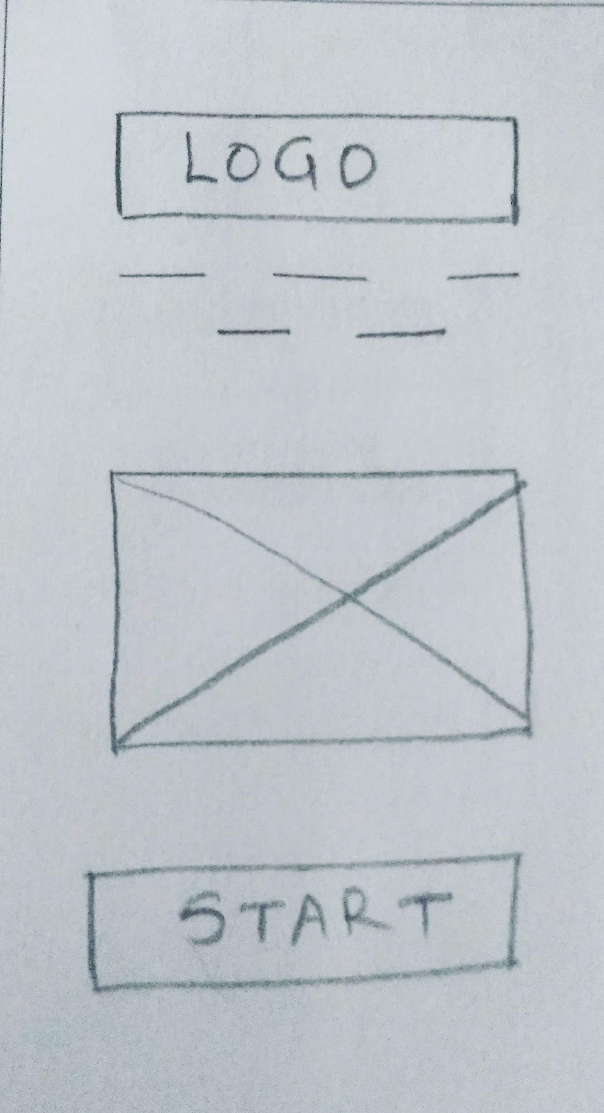
Click on image to view the prototypes
Original Prototype
Revised Prototype

